Slide 1

CS 533 INTRO TO DATA SCIENCE
Michael Ekstrand

Slide 2
GROUPS AND AGGREGATES

Slide 3

Learning Outcomes
Compute aggregate values from a Pandas series
Compute grouped aggregate values from a Pandas data frame
Order a data frame
Join two Pandas data frames for additional context
Photo by jean wimmerlin on Unsplash

Slide 4
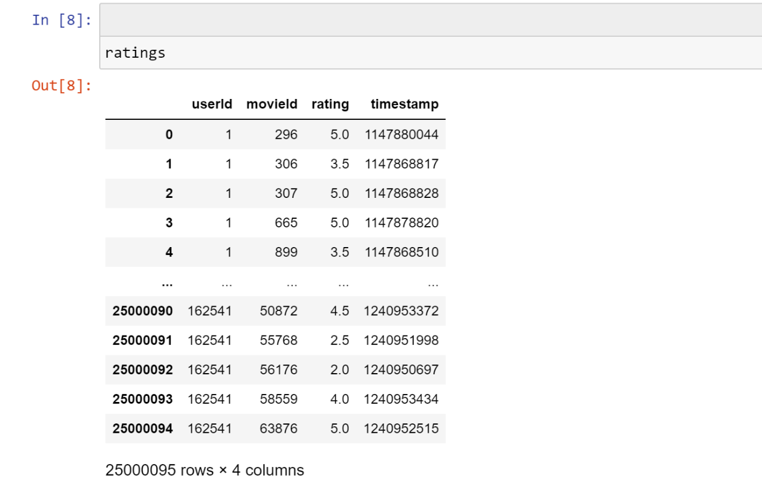
Data Frame

Slide 5
Aggregates
What’s the mean rating?
ratings['rating'].mean()
Use data frame
Select column rating
Compute mean
What’s the conceptual problem here?

Slide 6
Aggregate Functions
Many aggregates:
mean
median
mode
min / max
sum
count
std (standard deviation)
var (variance)
All are methods on pandas Series.

Slide 7
Count and Length
Total size of series, including missing values:
series.size
len(series)
Number of values, not including missing data:
series.count()

Slide 8
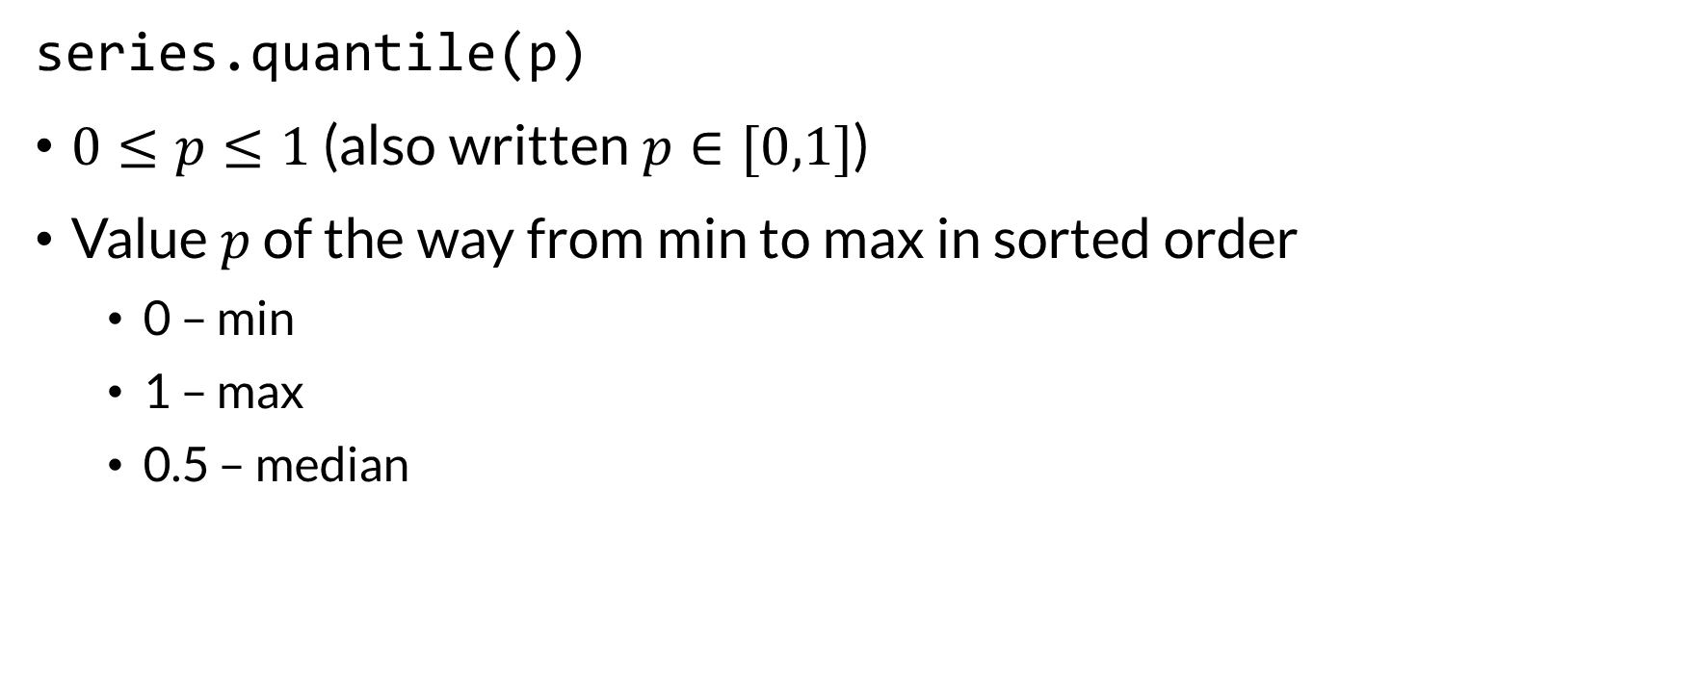
Quantiles
series.quantile(p)
$0≤p≤1$ (also written $p∈[0,1]$)
Value $p$ of the way from min to max in sorted order
0 – min
1 – max
0.5 – median

Slide 9
Grouped Aggregates
Remember: # of ratings per movie could be a movie variable?
ratings.groupby('movieId')['rating'].count()
Yields a Series:
indexed by movieId
Values are # of ratings per movie
We’re only aggregating one series
If we did the other way, we wouldn’t have a movieid to group by!

Slide 10
Multiple Aggregates
See notebook…

Slide 11
Sorting
Sometimes we want to sort data:
sort_values(col) re-sorts the data
Sometimes we just need that to get the largest or smallest:
nlargest(n, col) gets n rows with largest values of col
nsmallest(n, col) gets the smallest

Slide 12
Joining
Joining two frames lets us combine data
Simplest: join on common index
set_index sets the index
join joins two frames (by default on their indexes)
Can specify join columns
More later (including in readings)

Slide 13
Aggregating Aggregates
Our movie-level rating statistics are just more variables!
That can be aggregated.
Practice: compute the mean # of ratings per movie

Slide 14

Wrapping Up
Aggregates combine a series or array into a single value
Can compute over whole series, or over groups.
Join combines frames
Photo by Dwayne Legrand on Unsplash

